Slide 1
Introduction to Reinforcement Learning
Prof Kathryn Kasmarik
Reference: Sutton, R., Barto, A, 2014, Reinforcement Learning: An Introduction, 2nd Edition, MIT Press

Slide 2
Lecture Overview
Review of Reflex Agents
Learning Reflex Agents
Components of Reinforcement Learning
Maths of RL using a lookup table
Markov decision problems
Q-learning
Evaluating RL
Function approximation in RL
State space discretisation
Neural networks and deep learning

Slide 3
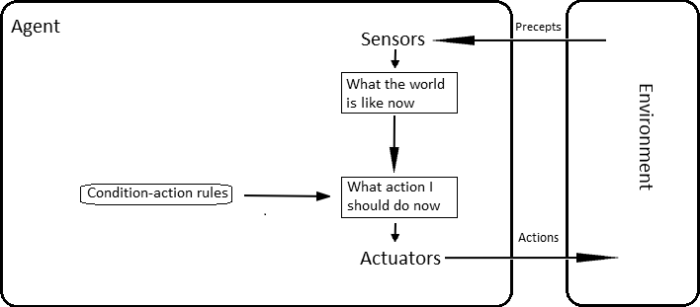
Reflex Agents
Recall the structure of a reflex agent:
Russell and Norvig, 2021

Slide 4
Learning Reflex Agents
Condition-action pairs are learned rather than ‘hard coded’:
How can we learn these rules?
Russell and Norvig, 2021

Slide 5
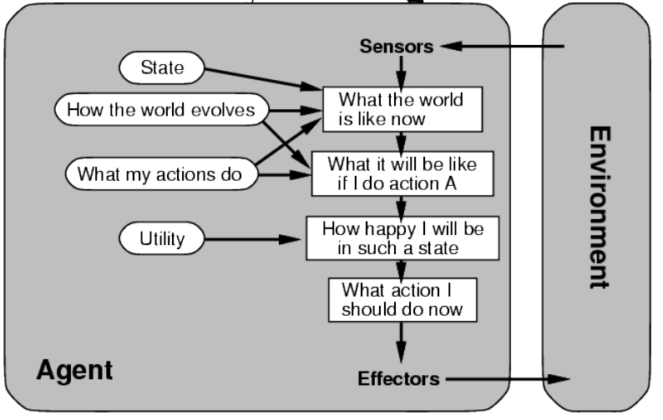
Utility-based agents
Learning is driven by a utility function (called a reward function) that defines the quality of states and/or actions

Slide 6
Reinforcement Learning
Learning by interaction with the environment
A trial-and-error process
But how does the agent know whether a trial is good or bad?
Answer: a reward signal

Slide 7
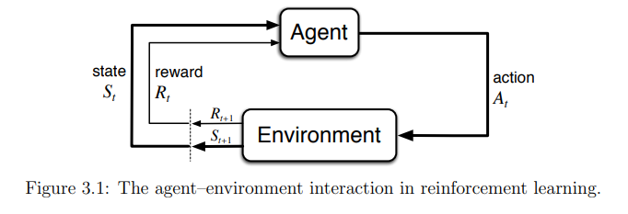
A Reinforcement Learning Agent
Recall the basic structure of a RL agent
Sutton and Barto, 2015

Slide 8
Example 1: Grid Environment
 |  |  | End +1
 |  |  | End -1
Start
https://towardsdatascience.com/reinforcement-learning-implement-grid-world-from-scratch-c5963765ebff

Slide 9
What is a state?
Whatever information is available to the agent
Measurements from sensors – maybe raw or processed
What is the state space of the grid-based environment example

Slide 10
What is an action?
Action refers to the mechanism which transmits the agent from the current state to a new state in the environment.
The action should transmits the agent to a possible and accessible state.
What kind of actions are available in the grid environment example?

Slide 11
Defining the Environment – The Markov Property
Recall the definition of deterministic environments
If an environment has the Markov property, then its one-step dynamics enable us to predict the next state and expected next reward given the current state and action
One step dynamics: p(s’, r|s, a) = Pr{R_{t+1} = r, S_{t+1} = s’ | S_{t} , A_{t}}
Give an example of an environment which has a Markov property?

Slide 12
Episodic vs Non-episodic Environments
Episodic tasks: agent-environment interactions break into separate interaction trajectories, after which interaction terminates and the agent is ‘reset’
Non-episodic tasks: interaction does not naturally break into episodes, but continues without limit.

Slide 13
Defining Reward
Reward is a mechanism which tells the agent what is correct and what is incorrect regarding the trial-and-error concept.
The reward allows the agent to evaluate the performance of changing from current state to a new state using an action.
A real-life example is giving a chocolate to a children once they tidy their room.
What is the reward in the grid environment example?

Slide 14
What should be considered in defining Reward
The agent does not know which actions to take. Instead it must discover which actions will result in the most reward.
Reward should be defined in a way to identify the goal of the RL problem. It should train the agent the in a way to reach the goal, while exploring the environment.
Some RL models include penalty to avoid a specific state, or to enhance the significance of the goal state.

Slide 15

Example 1: Grid Environment
https://www.youtube.com/watch?v=gn4nRCC9TwQ

Slide 16
Representing the ‘Condition-Action’ Rules as a State-Action Table (Q-Table)
 | A1 | A2 | A3 | A4
S1
S2
S3
S4
 | A1 | A2 | A3 | A4
S1 | 0.1 | 0.2 | 0.9 | 0.1
S2
S3
S4
Q-values

Slide 17
How to select an action from a Q-table?
Always select the action with the highest q-value…
Always select a random action…
Something else…?

Slide 18
Exploration Vs Exploitation
Exploration: trying more (state,action) pairs to gain more information about the environment.
Exploitation: taking actions that the agent explored before and based on what it learned earlier (policy) it knows it will result in the highest expected reward.
Challenge : balancing these two terms

Slide 19
E-greedy exploration
Select the action with the highest q-value most of the time, and a random action the rest of the time

Slide 20
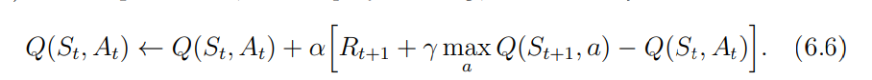
How to update (learn) the q-values?
Store the immediate reward received in each state after each action is performed?
Requires that every state returns some reward for learning to occur
What if we could ‘back up’ reward from the states that receive it, into the states that lead up to it

Slide 21
How to initialise a q-table?
Randomly?
All zero?
All ‘1’ (or any high number relative to maximum possible reward)

Slide 22
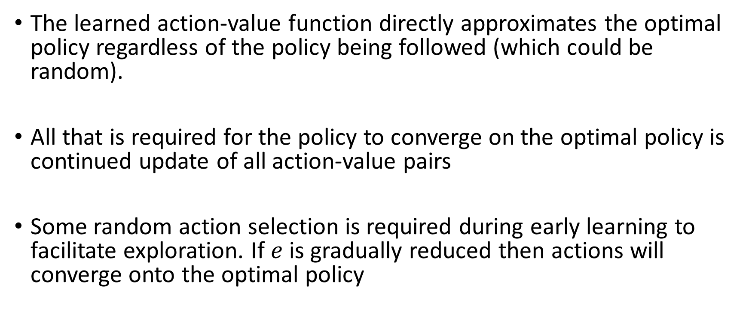
Properties of Q-learning
The learned action-value function directly approximates the optimal policy regardless of the policy being followed (which could be random).
All that is required for the policy to converge on the optimal policy is continued update of all action-value pairs
Some random action selection is required during early learning to facilitate exploration. If $e$ is gradually reduced then actions will converge onto the optimal policy

Slide 23
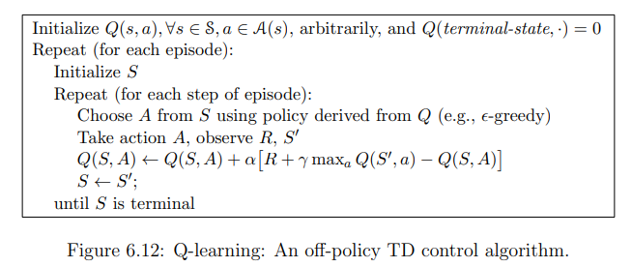
Putting it all together – the Q-learning algorithm

Slide 24
A variant - SARSA
Sutton and Barto, 2015

Slide 25
Q-Learning vs SARSA
Q-value update:
SARSA updates its Q-values based on the current policy's actions.
Q-Learning, updates its Q-values based on the maximum Q-value of the next state, regardless of the action taken by the current policy.
Q-learning tends to converge to the optimal policy faster than SARSA because it directly learns the maximum possible future reward at each state, regardless of the action taken.
SARSA, may explore more conservative policies since it updates its Q-values based on the actions it would actually take under the current policy.

Slide 26
Evaluating RL performance
Episode Reward : the average reward of all steps of current episode
Average Reward : the average reward up until the current episode
Long-term reward : the reward of entire action sequences and their consequences.
Episodic Reward chart : put all above into a chart
Number of actions : number of actions taken in each episode
Training and Testing time : clock time taken for training and evaluation

Slide 27
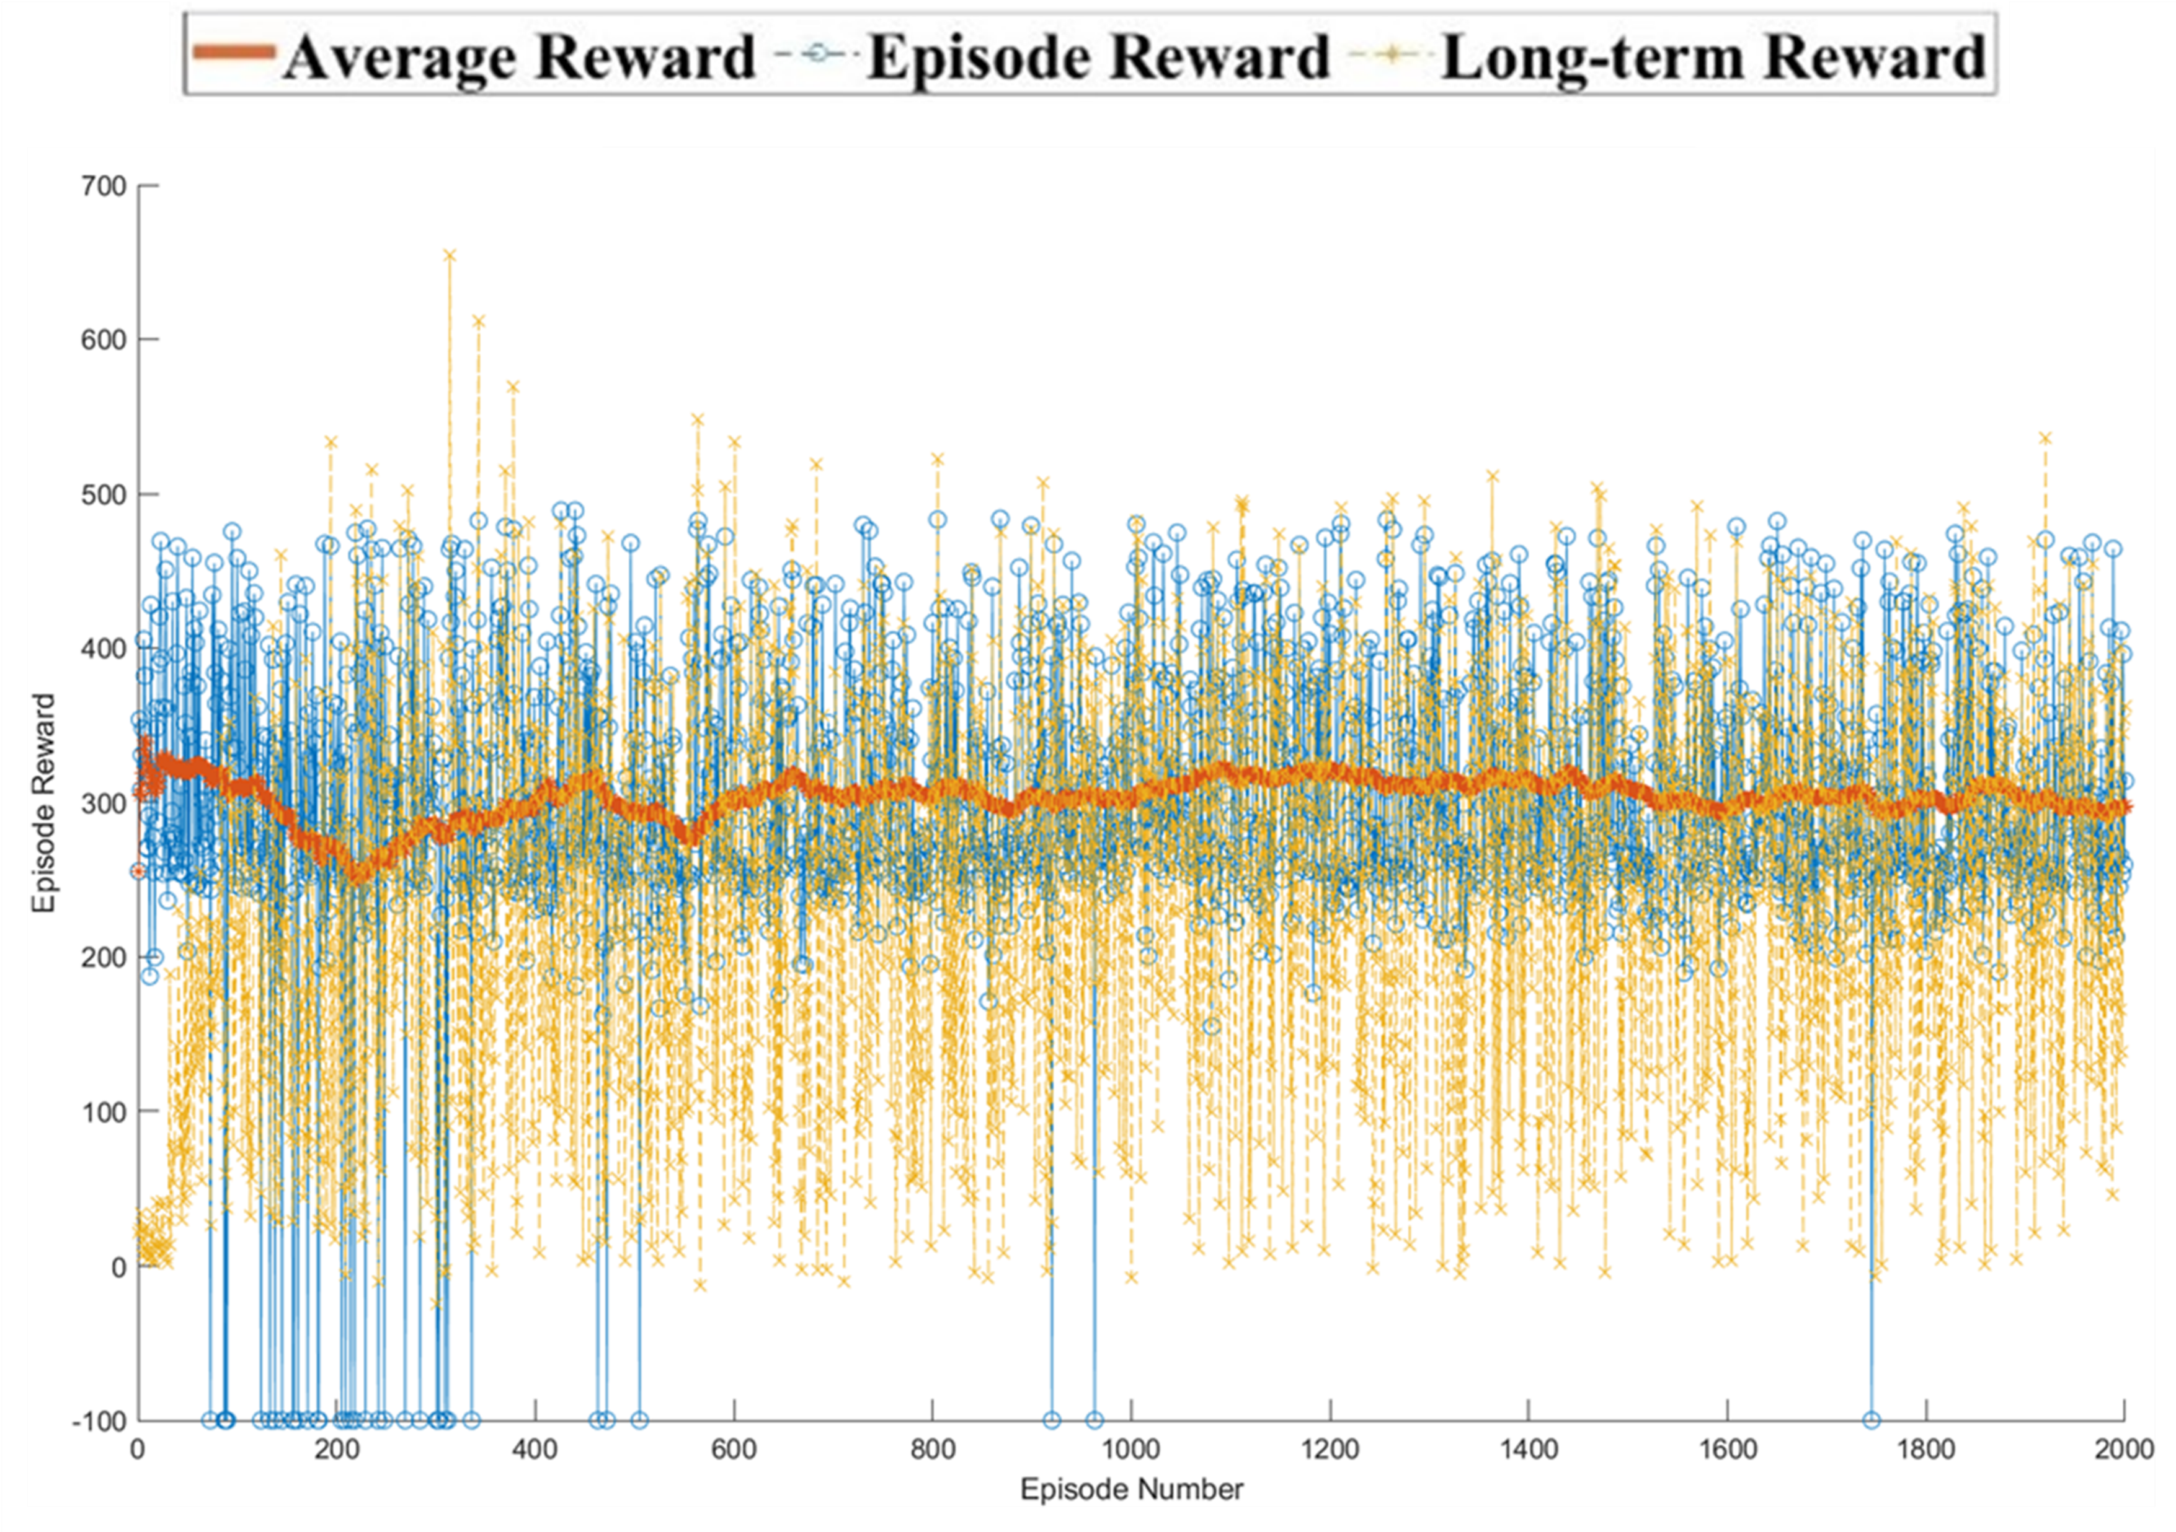
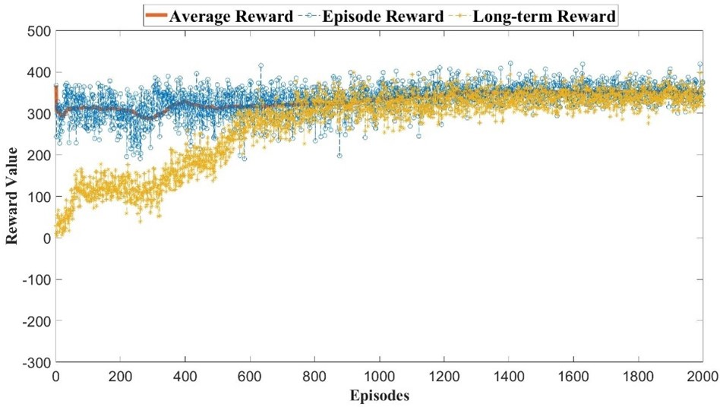
Evaluating RL performance

Slide 28
Lecture Summary
After todays’ lecture you should be able to:
Define components of Reinforcement Learning
Define MDP
Implement the maths of RL using a lookup table
Evaluate RL
Use state space discretisation as a basic form of function approximation

